Slide 1
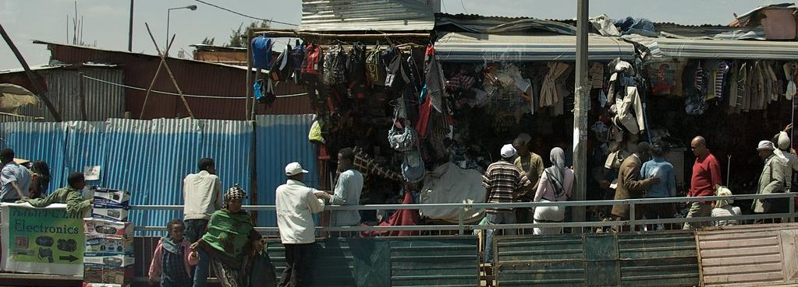
Join us in prayer for
ETHIOPIA
"Ethiopian Street Scene" by A.Davey is licensed under CC BY 2.0

Slide 2
God our Saviour desires all people to be saved and to come to a knowledge of the truth.
1 Timothy 2:4
Photo by Aaron Burden on Unsplash

Slide 3
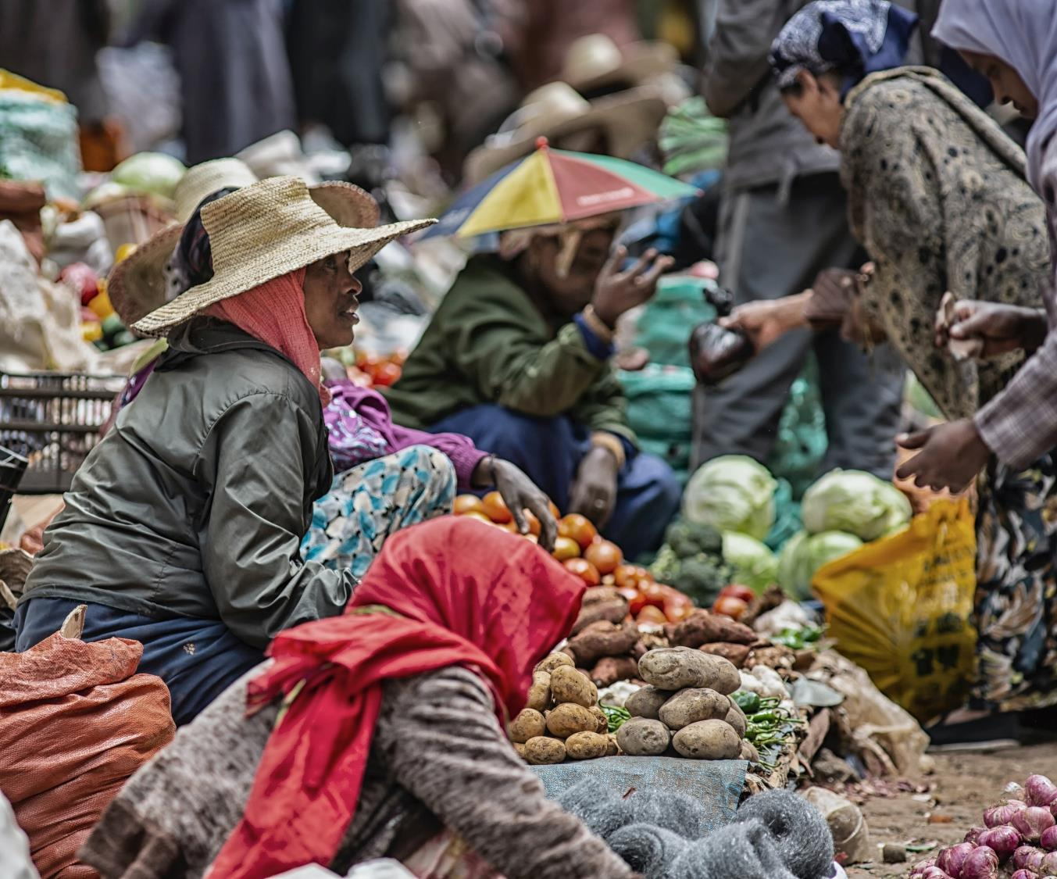
SIM Ethiopia strive to expand the Church’s capacity to make disciples and multiply churches in communities where Christ is least known.

Slide 4
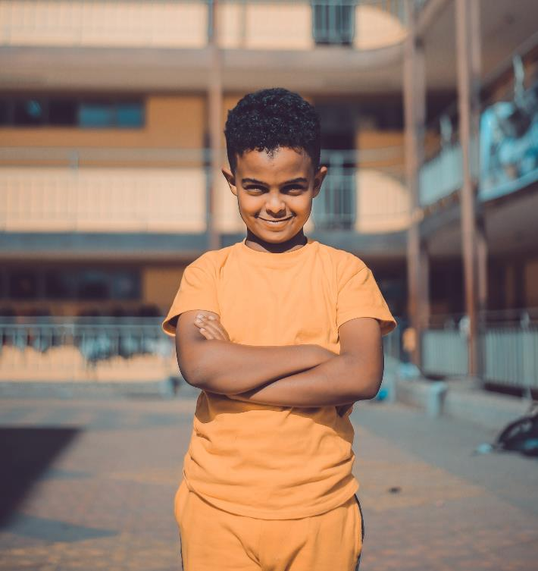
Communities where
Christ is least known
Children and youth
Well over half of Ethiopia’s population are under the age of 20.
Most have limited opportunities to come to know Christ.
Photo by Gift Habeshaw on Unsplash

Slide 5
PRAY
Children and youth
Pray for people to work with the Ethiopian church to provide children and youth ministries.
Pray for the provision of gospel-hearted teachers to serve at Bingham Academy with a passion for making disciples among students.
Photo by Gift Habeshaw on Unsplash

Slide 6
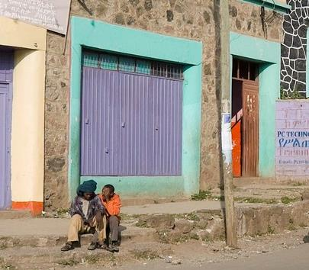
Communities where
Christ is least known
Vulnerable
The urban population is steadily increasing in this primarily rural country.
Poverty and abuse are major issues, especially among newcomers to urban areas.
Girls and homeless street boys are at risk of being trafficked.
"The Colors of Ethiopia" by A.Davey is licensed under CC BY 2.0

Slide 7
PRAY
Vulnerable
Pray the Lord’s protection over the vulnerable.
Pray that the Ethiopian Church will recognise their role in caring for those who are vulnerable in their communities.
"The Colors of Ethiopia" by A.Davey is licensed under CC BY 2.0

Slide 8
Prayer requests from
THE SIM TEAM
PLEASE PRAY:
For Christian business, community and church leaders who are strategically placed to have an impact where Christ is least known.
For greater interdependent teamwork and healthy ministry relationships.
For teaching, disciple making and mentoring initiatives in Orthodox communities.
That churches will be empowered for missional outreach.

Slide 9
Is God calling you to Ethiopia?
There are opportunities to serve alongside the Ethiopian Church in:
Caring for the vulnerable
Engaging with community influencers
Mentoring and training in Orthodox communities
Outreach to Muslims
Medical ministry
Discipling and equipping church leaders
There are also opportunities in:
Missionary Kid education
Print and radio media

Slide 10
Thank you for your prayers
For more information, prayer resources, or if you are interested in serving, please visit sim.co.uk

