Slide 1
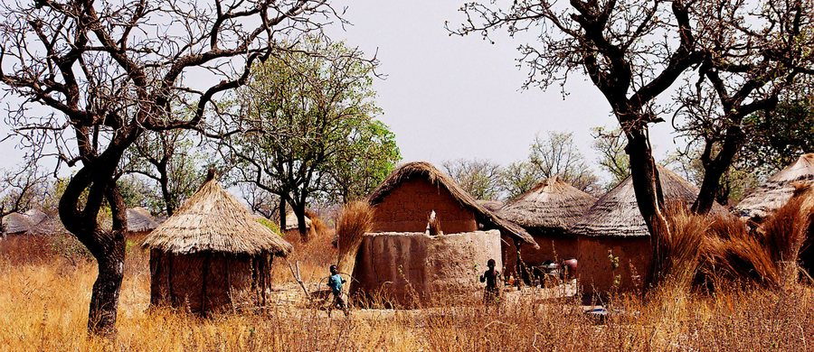
PRAY FOR GHANA
A New Ministry to the Fulani

Slide 2
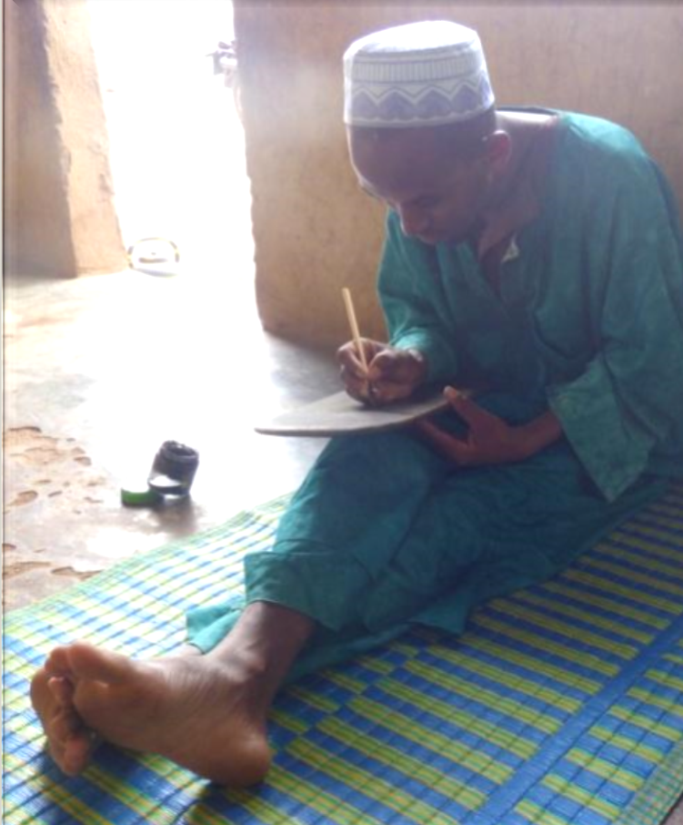
Fulani
There are 40 million Fulani in 17 countries across West Africa. About 800,000 are in Ghana
Traditionally they are nomadic herders of cattle, sheep & goats
They are almost entirely Muslim
Fulani Christian communities exist in neighboring countries

Slide 3
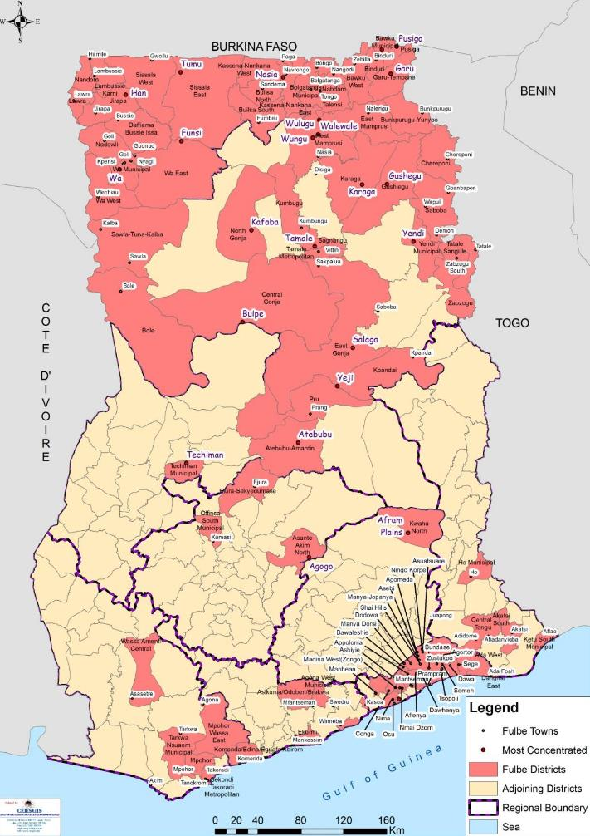
Distribution of Fulani Settlements in Ghana
Fulani live in the areas shaded in red.

Slide 4
Team locations
Tamale
Buipe

Slide 5
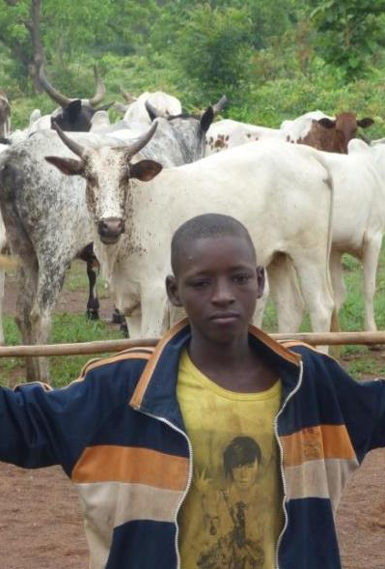
Vision of Fulani Ministry
We see a witness to Christ’s love among the Fulani
We see Fulani disciples of Jesus with a deep understanding of God’s Word, who express God’s love in their communities and worship together and share the Gospel locally and globally

Slide 6
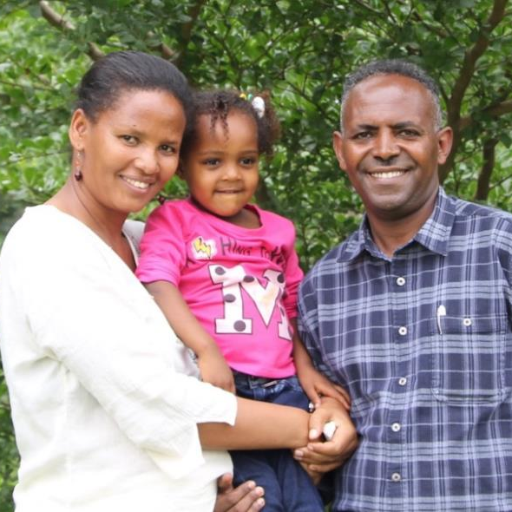
Introducing our first team members
Mesfine & Asefash
with Barnabas & Naomi
Eshetu & Dawit with Abigiya

Slide 7
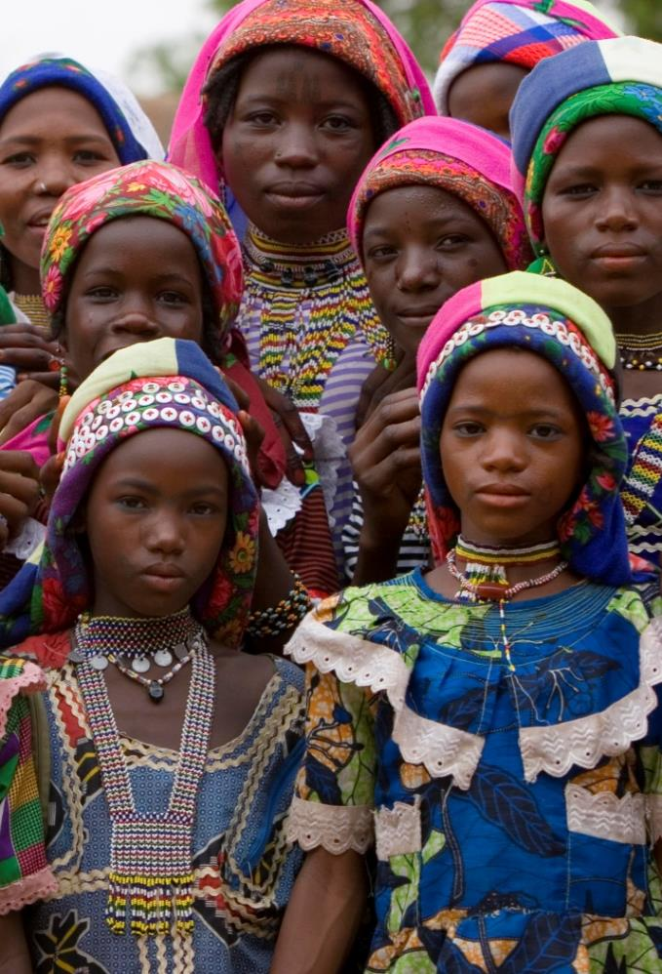
Praise God for…
Calling these two families to Ghana to serve amongst the Fulani.
Providing housing and good schools for the children (Tamale).
Giving them good friends in Buipe, including Djalo, a Fulani pastor, who is helping them settle well.

Slide 8
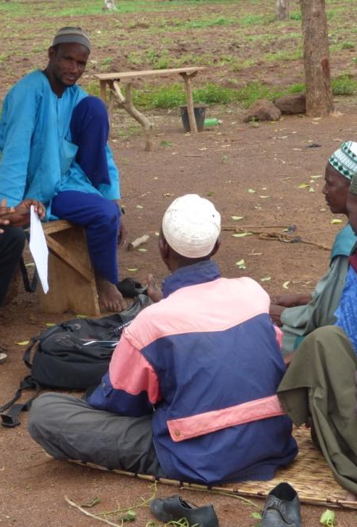
Please pray
For the families as the children settle into new schools and for them to make good friends in Tamale and Buipe
For Mesfin and Dawit, Eshetu and Asefash as they learn the Fulani language
That God would protect these families physically and spiritually, and that He would open doors for ministry.
For other missionaries to join this team

Slide 9
Thank you for your prayers
For more information, prayer resources, or if you are interested in serving, please visit sim.co.uk

