Slide 1
PRAY FOR KENYA

Slide 2
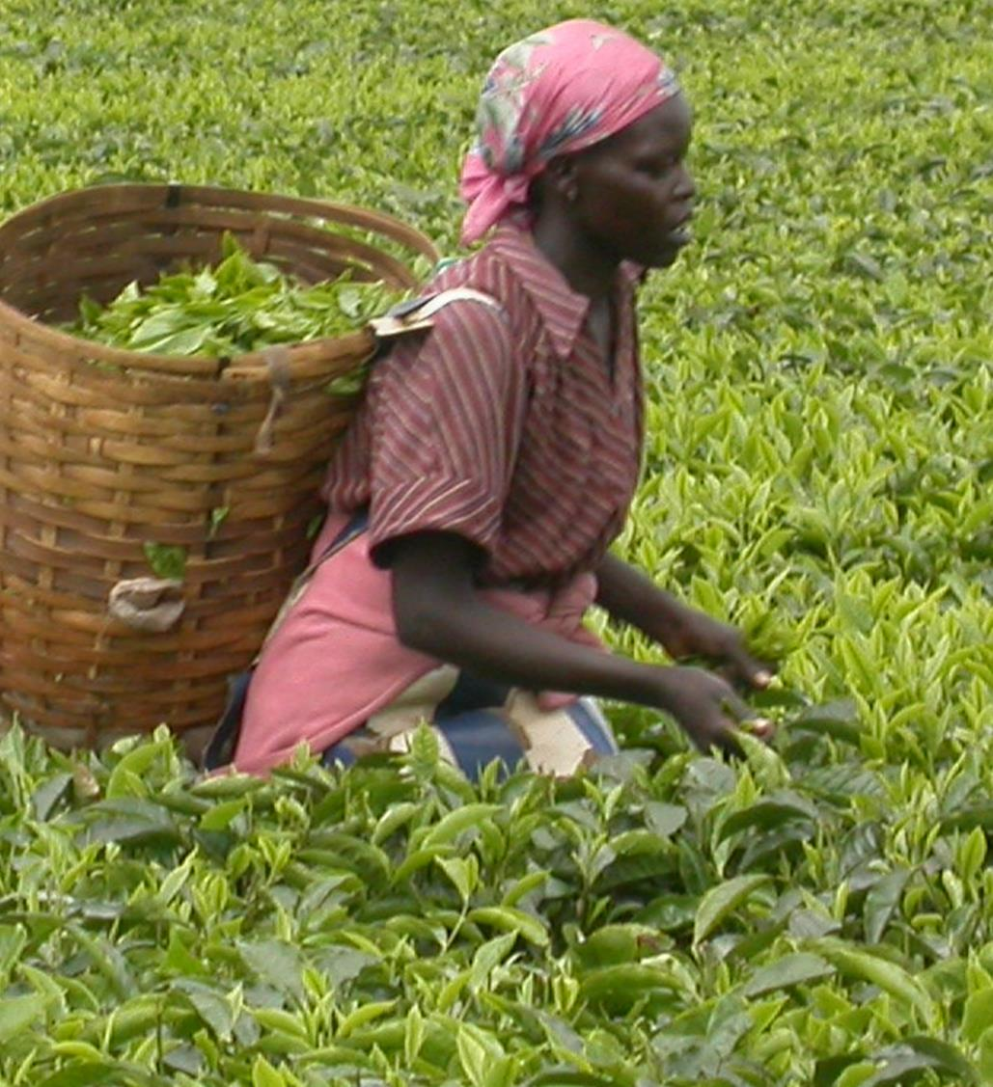
Don't you have a saying, 'It's still four months until harvest'? I tell you, open your eyes and look at the fields! They are ripe for harvest.
John 4:35

Slide 3
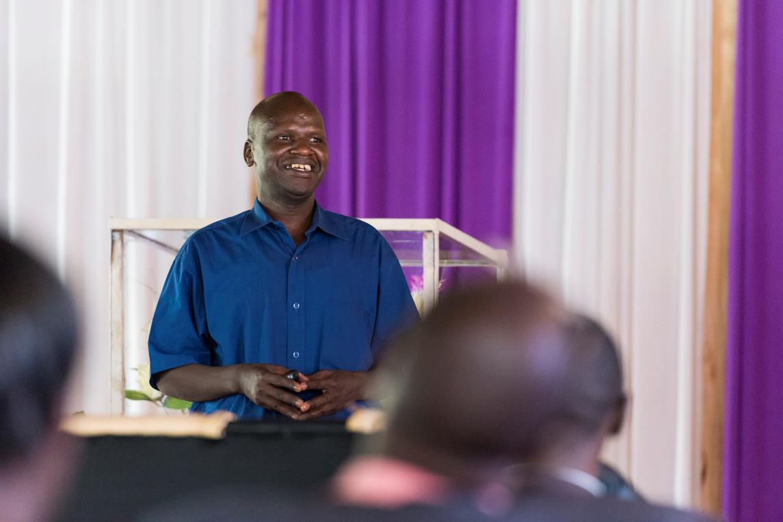
As we passionately pursue our divine calling, we want to see through our ministries: flourishing, prayerful missionaries practising disciple-making and accountability.

Slide 4
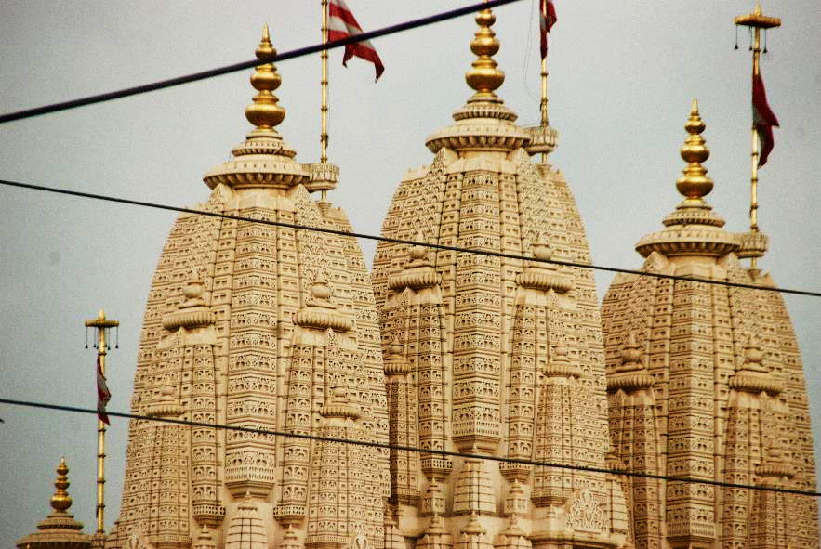
Communities where Christ is least known
Gujarati
0.1% of Gujarati people in Kenya are Christians. 0.02% are evangelicals.
Roughly 1/2 are Hindu, 13% are Muslim, and 1/3 belong to other small Indian-based religions.
Family structures make it difficult to be open to new ideas from outside their community.

Slide 5
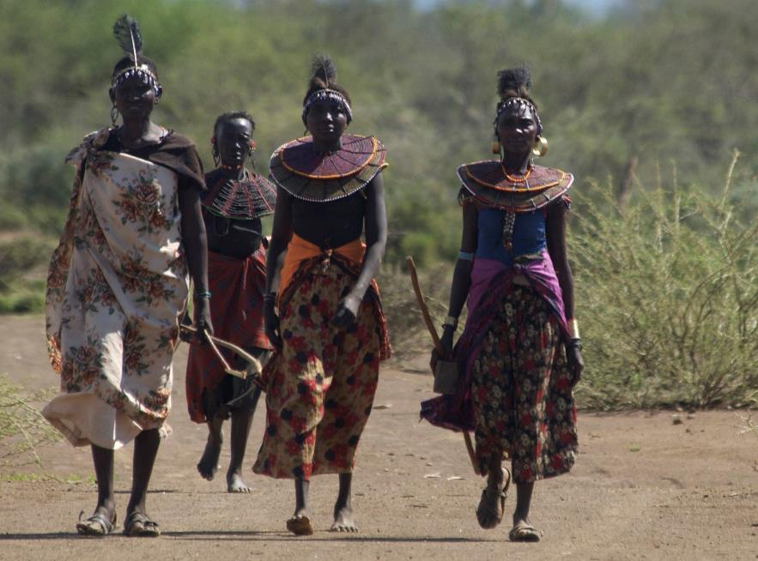
Communities where Christ is least known
Pokot
800,000 Pokot people live in Kenya. They are traditionally herdsmen of cattle and sheep, and measure wealth in how many cattle they posses.
They worship the god Tororot and other deities, and communicate with them through prayers and sacrifices.

Slide 6
Communities where Christ is least known
Pokot
The Pokot have a great fear of death because they do not believe in an afterlife.
Many of their religious rituals involve warding off illnesses or effecting cures.

Slide 7
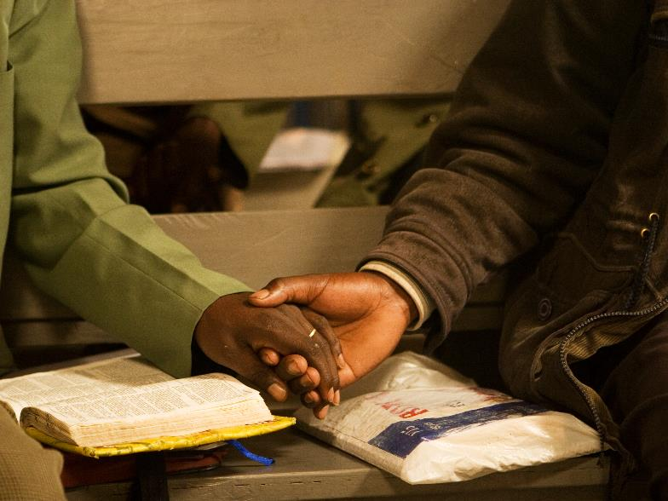
Prayer requests from our SIM team
Please pray for:
more workers especially for the difficult areas of Kenya.
more opportunities to partner with churches to make disciples in unreached communities. Some groups are very resistant to the gospel.

Slide 8
Prayer requests from our SIM team
Please pray for:
business workers to do outreach and discipleship among the Hindus in the urban areas.
For the Kenyan church to be mobilised and empowered to reach communities for Christ, both in Kenya and internationally.

Slide 9
Ministries in Kenya:
Disciple-making among vulnerable children
Youth ministry
Youth disciple-making and mentoring
Outreach and disciple-making among Hindus, Muslims and communities still practising traditional religions
Investing in the Kenya churches through leadership training, Sports Friends training and Banda Health
Medical care

Slide 10
Thank you for your prayers
For more information, prayer resources, or if you are interested in serving, please visit sim.co.uk

