Slide 1
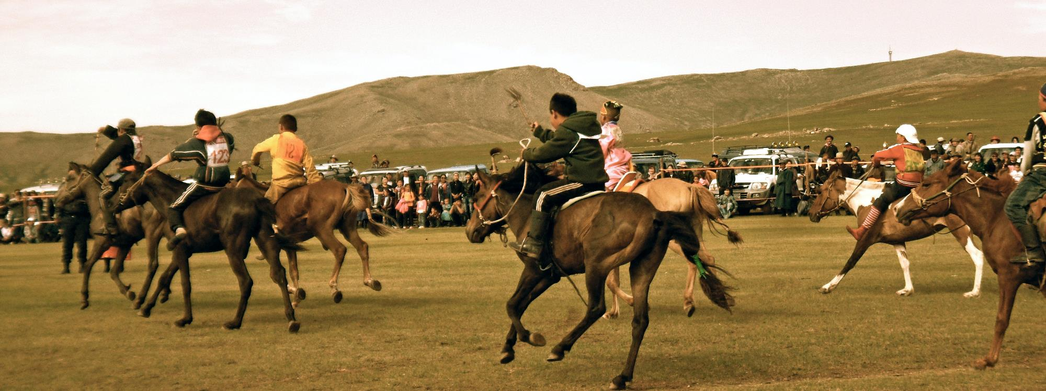
PRAY FOR MONGOLIA

Slide 2
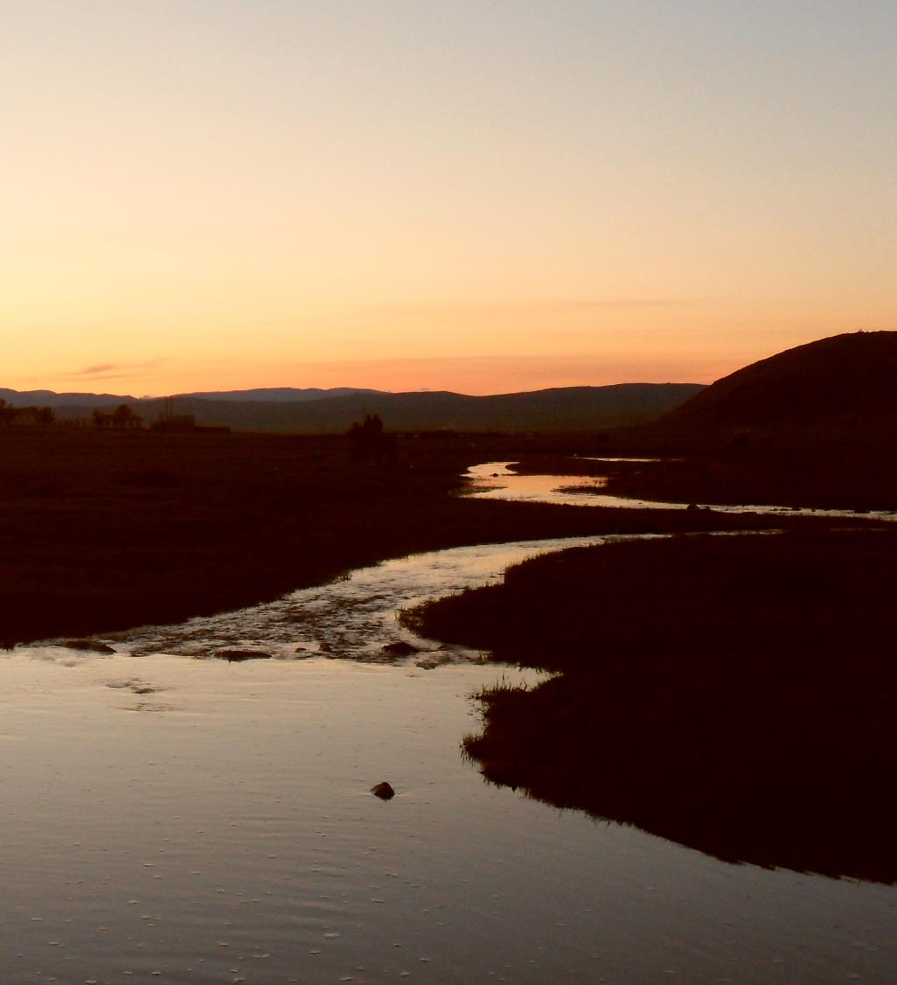
See, I am doing a new thing! Now it springs up; do you not perceive it? I am making a way in the wilderness and streams in the wasteland.
Isaiah 43:19

Slide 3
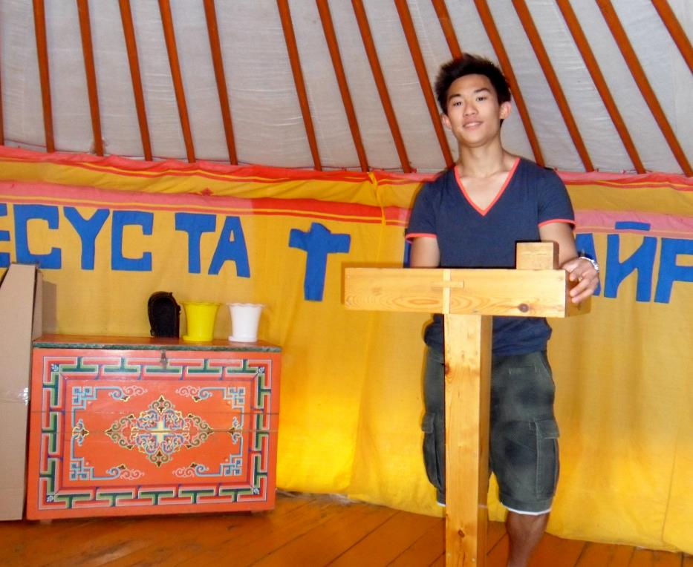
In response to God’s love, SIM Mongolia desires to serve the Mongolian church through loving and compassionate relationships.

Slide 4
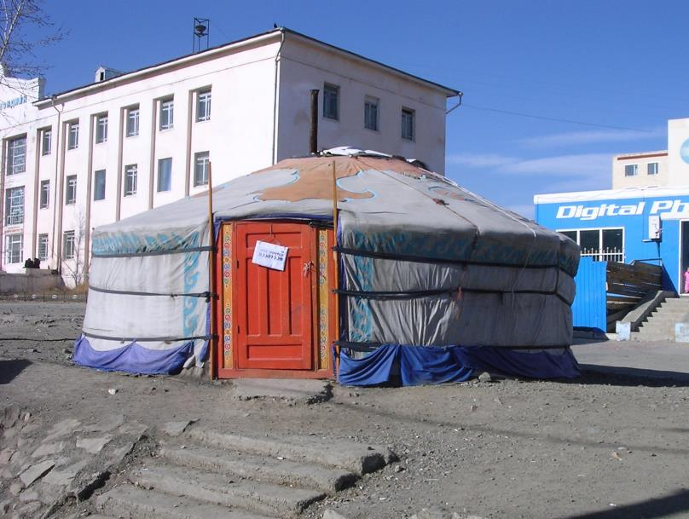
COMMUNITIES WHERE CHRIST IS LEAST KNOWN
Urban communities in Ulaanbaatar
Nearly half the population live in the capital city, Ulaanbaatar.
The city is divided into two groups — those who live in apartment buildings and those who live in the Ger districts.
Gers are traditional tent houses. The Ger districts ringing the city are expanding every year.

Slide 5
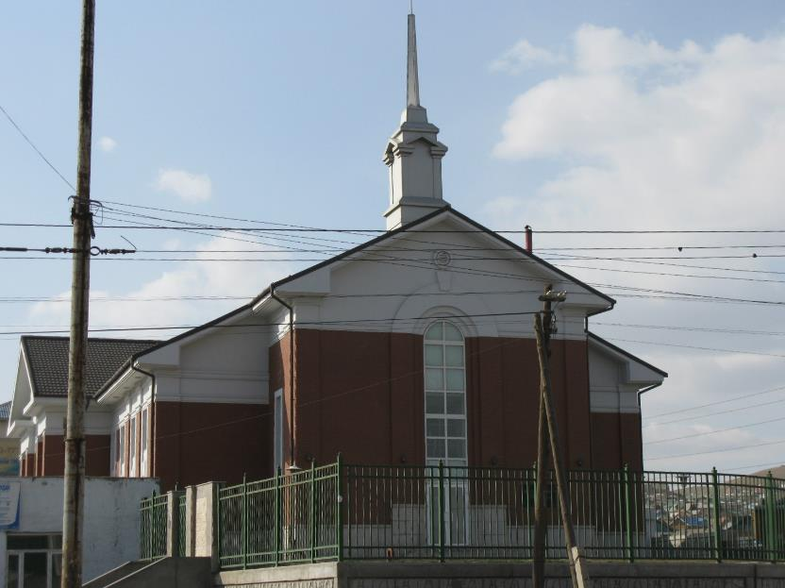
COMMUNITIES WHERE CHRIST IS LEAST KNOWN
Urban communities in Ulaanbaatar
Revival came to the city in the mid-1990s to the early 2000s, when many showed interest in Christianity. However, the city is now facing rapid secularisation.
The Mongolian church is well-established, but there is a great need for new approaches in evangelism and ministry.
SIM partners with local leaders to develop and facilitate urban outreach.

Slide 6
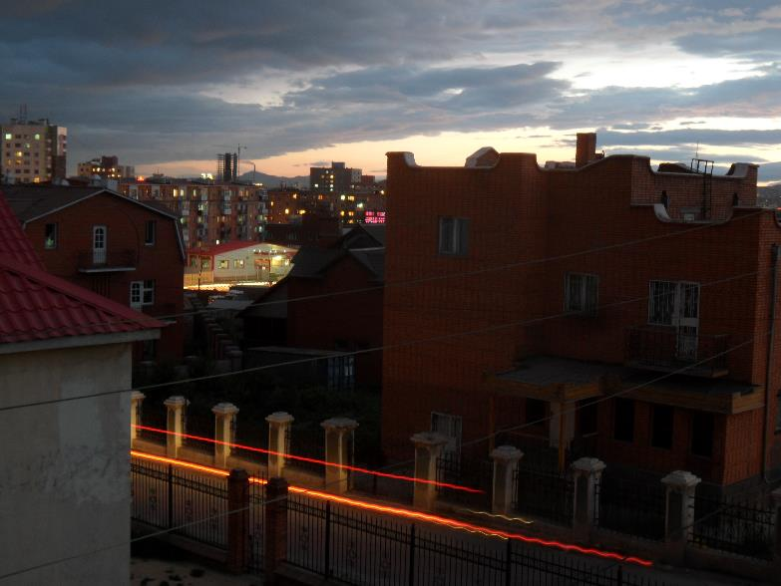
PRAYER REQUESTS FOR MONGOLIA
Pray for…
more workers.
the revival of Mongolian churches through a new generation of servant leaders.
God to raise up a new country director for SIM Mongolia, to lead a unified team and develop partnerships with local churches.
follow-up with local churches who are inviting mission agencies to reach out to communities.

Slide 7
MINISTRIES IN MONGOLIA
Church planting and disciple-making
Training next generation leaders in counselling and pastoral leadership
English teaching
Youth ministry
Medical outreach
NGO training and administration
Nomadic community outreach
Urban outreach

Slide 8
Thank you for your prayers
For more information, prayer resources, or if you are interested in serving, please visit sim.co.uk

